Slide 1


HPV Vaccinations:
A Community Health Worker’s Role
ECHO Series
Session 0:
Orientation & Networking
Wednesday, July 19th, 2023
12-1:15pm PST
This Photo by Unknown Author is licensed under CC BY
Notes:
Ashley to welcome participants

Slide 2









ECHO Disclosures
  Each ECHO session will be recorded and will be posted to a publicly-facing website
  You will be muted with your video turned off when you join the call. Use the buttons in the black menu bar to unmute your line and to turn on your video. If you do not wish to have your image recorded, please turn OFF the video option.
  Today’s materials will be made available on the ACS ECHO website
  Please type your full name, the full name of your organization, and e-mail in the chat box
  This ECHO session takes place on the Zoom platform. To review Zoom’s privacy policy, please visit zoom.us/privacy
  Remember: Do NOT share any personal health information (PHI) about any patient. This includes but not limited to​ patient name​, date of birth​, address, occupation, name of friends/family, and any other identifiable features (including scars, tattoos, hair/eye color)​
This ECHO is made possible through funding from Merck, for the purpose of Mission: HPV Cancer Free Quality Improvement Initiative.
  Need assistance with Zoom? Please directly chat Jenny, Troy, Allison, or Alyssa for assistance
2
Notes:
Ashley: read through disclosures
Today’s Session will NOT serve as a typical ECHO session but instead will function more like a traditional interactive webinar

Slide 3





Housekeeping Items:
Show up
Use the technology
Arrive on time, prepared, camera on and please unplug from distractions
Mute, unmute, camera on, chat, annotate and answer polls
Roll with the IT punches
Respect other ideas, experiences and opinions
Enjoy watching us model live IT troubleshooting
Step Up / Step Back
Try on new ideas
Check your own engagement level
Give yourself permission to take risks with participating
Have fun!

Slide 4

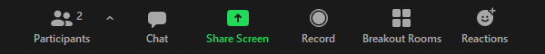
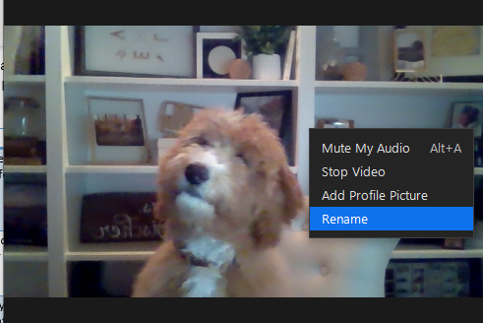

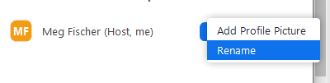
Zoom Essentials for Training
Please Rename Yourself
  First, Last Name, Organization
Option 1
Option 2
Right-click on your video tile
1
2
1
3
Notes:
Ashley
Option 1:
Open the Participants box, hover over your name and select More. Select Rename from the options list and update your name to include your first and last name and the clinic you are representing.
Option 2:
Hover your video feed and select the three dots at the top right corner image. From this options list, select Rename and update your name to include your first and last name and the clinic you are representing.

Slide 5
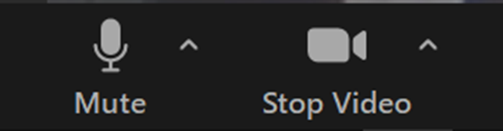
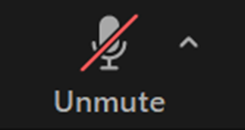
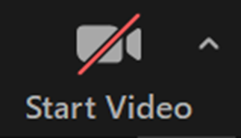
Zoom Essentials for Training
How to Access Your Camera & Microphone
If you move your mouse around on your screen you should see two options appear in the bottom left corner: Mute and Video
By clicking on the microphone, you can mute and unmute your audio
By clicking on start video or stop video you can turn your camera on and off
Notes:
Ashley

Slide 6
Disclosure Policy
As an accredited provider of continuing medical education through the Accreditation Council for Continuing Medical Education (ACCME) the University of Nevada, Reno School of Medicine must ensure balance, independence, objectivity, and scientific rigor in all its educational activities. In order to assure that information is presented in a scientific and objective manner, The University of Nevada, Reno School of Medicine requires that anyone in a position to control or influence the content of an accredited activity disclose all financial relationships within the prior 24 months with any commercial or proprietary entity producing health care goods or services relevant to the content being planned or presented. All relevant financial relationships have been mitigated. Following are those disclosures. Following are those disclosures. ​
The following presenter has/have disclosed the following relationship with an ineligible entity:
Ashley Lach, MHA, CPHQ
  Grant/Research Support: Merck
Allison Rosen, MS
  Consultant: Bayer Oncology
Sean O'Leary, MD
  Merck
All other presenters, planners, or anyone in a position to control the content of this continuing medical education activity have indicated that neither they nor their spouse/legally recognized domestic partner has any financial relationships with commercial interests related to the content of this activity.
​
​
Notes:
Ashley
Transition to Sandy

Slide 7

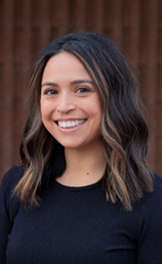
Session 0:
Agenda & Introductions
Sandy Hartman
Associate Director, Community Partnerships
American Cancer Society
Notes:
Sandy

Slide 8


Today’s Agenda
1
5
Sample Didactic Presentation
10 minutes
Welcome & Housekeeping
5 minutes
2
ECHO Subject Matter Expert (SME) & Support Team Introductions
10 minutes
6
Sample Case Presentation
10 minutes
3
7
Q&A & Wrap up
10 minutes
ECHO Participant Introductions
15 minutes
4
Introduction to the ECHO Model
15 minutes
8
Notes:
Sandy

Slide 9

Learning Objectives
1
Participants will become familiar with ECHO Subject Matter Experts and Support Team
2
Participants will network and make introductions to create a learning community
3
Participants will gain knowledge on Project ECHO model
4
Participants will review a sample didactic presentation
5
Participants will examine a sample case presentation
9
Notes:
Sandy

Slide 10
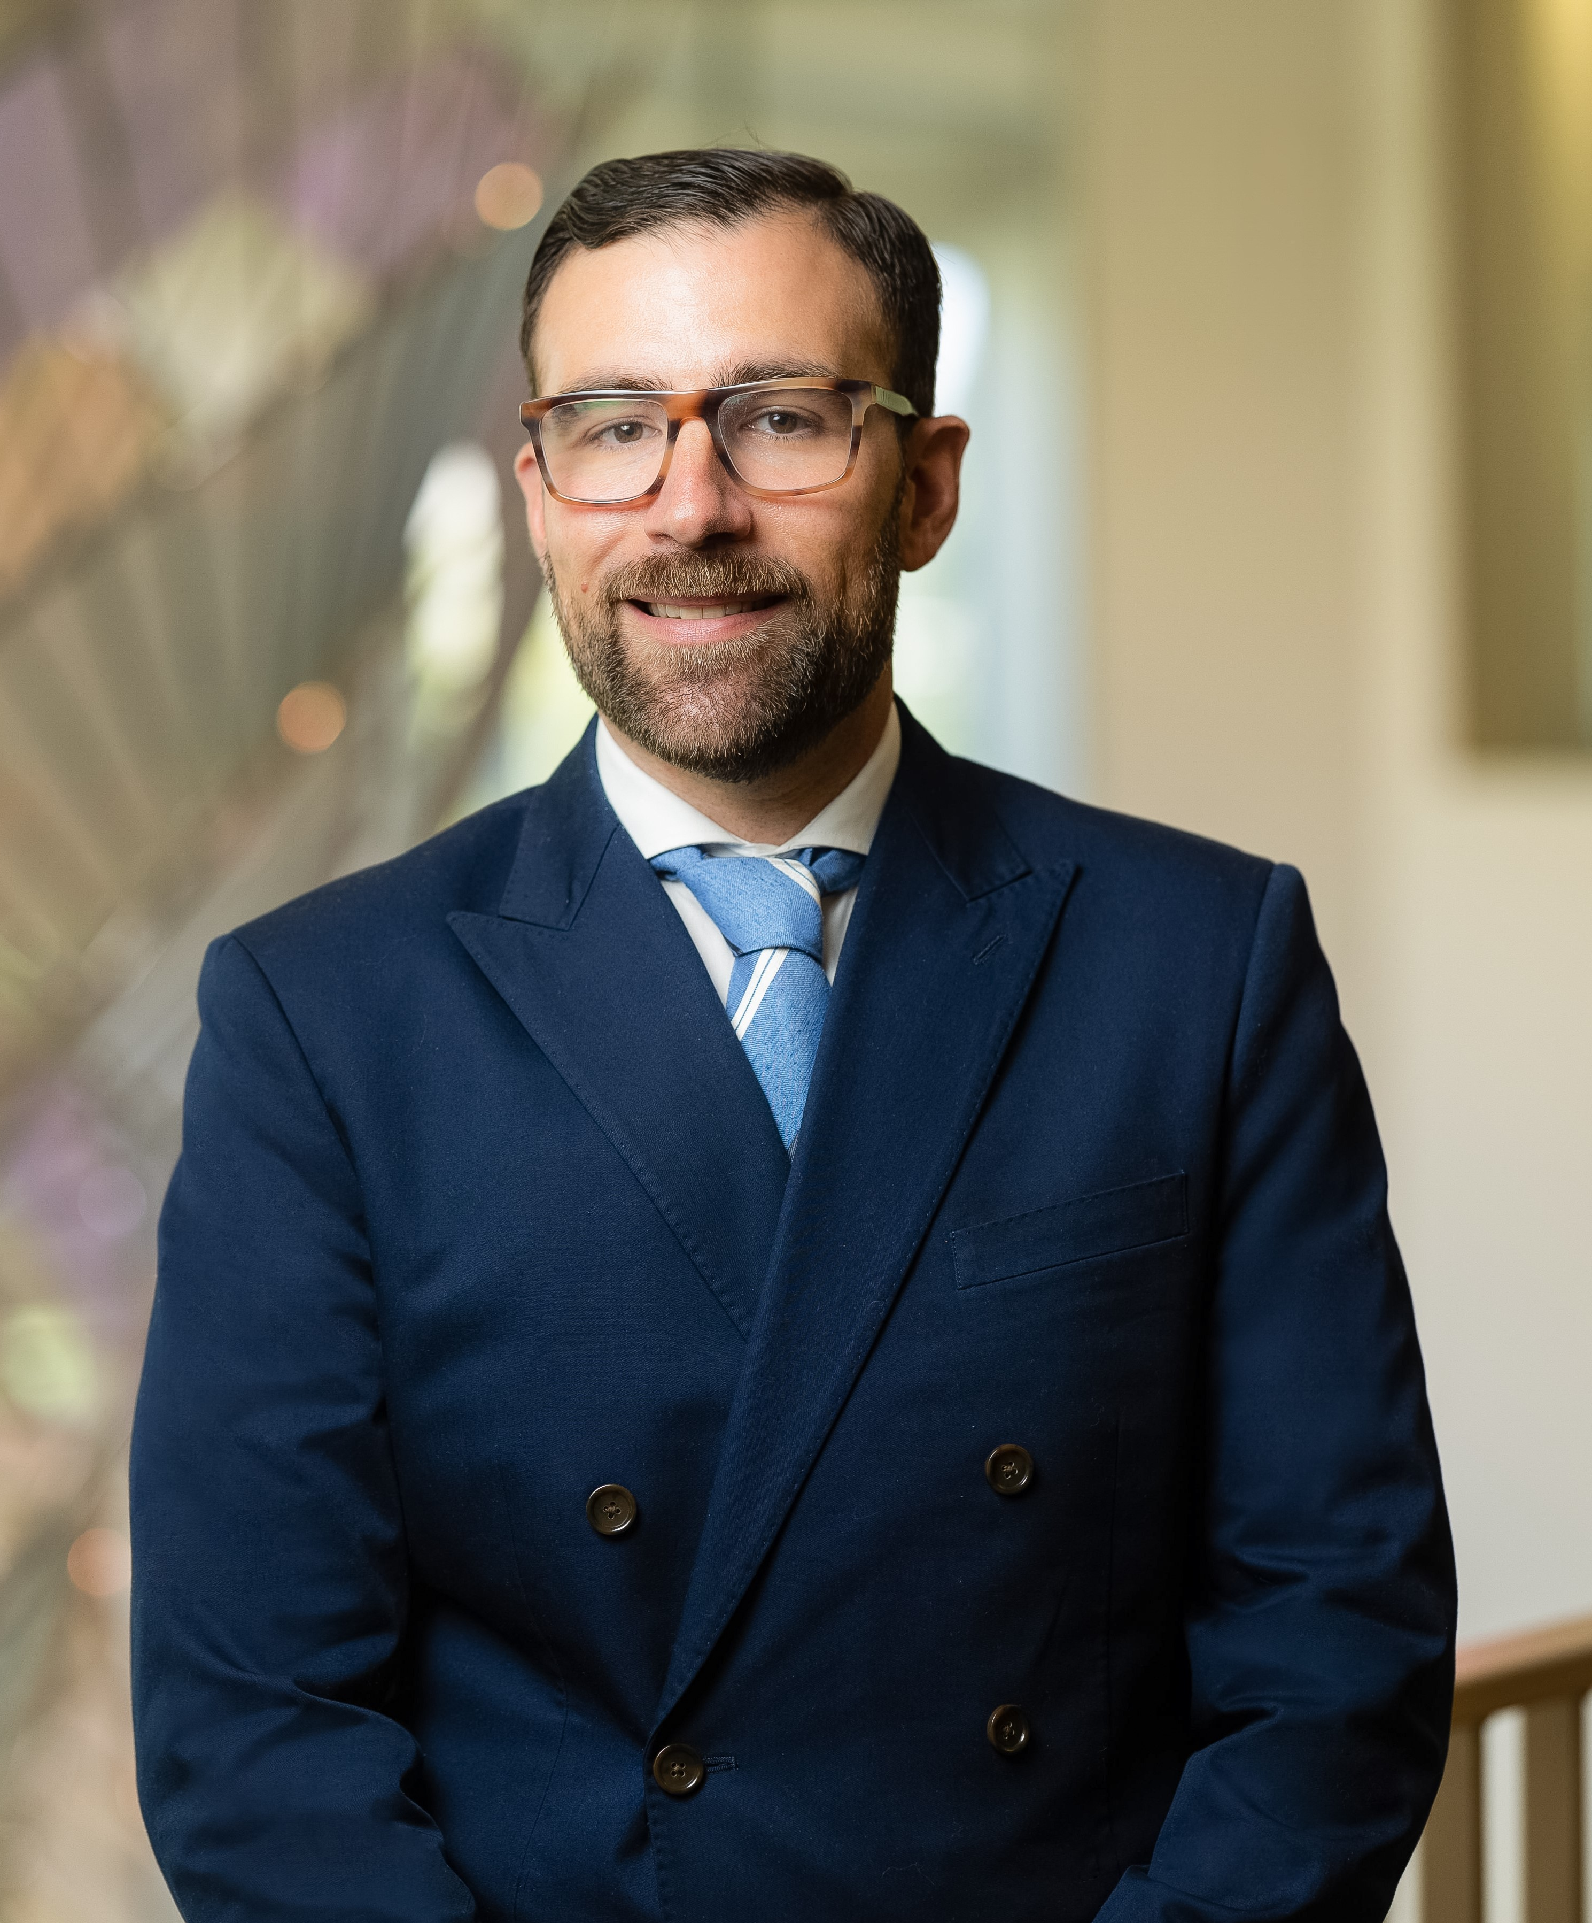
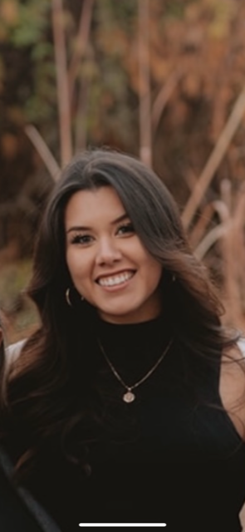
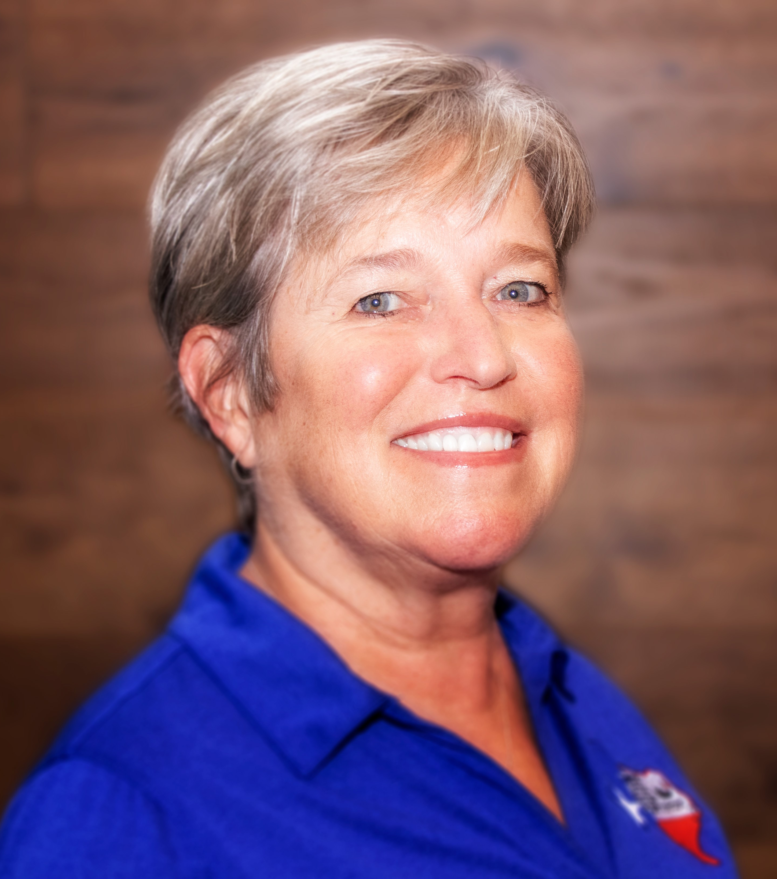
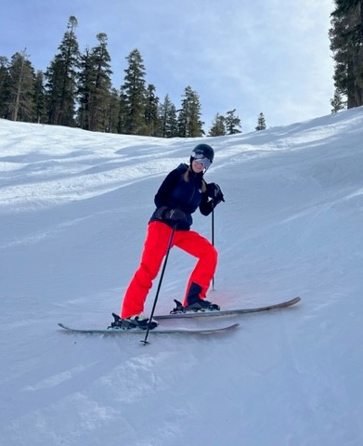
Introductions: Meet Our HUB Subject Matter Experts (SMEs)
Jose Cucalon-Calderon, MD
Associate Professor; Pediatrics Department:
Vaccination Representative, Nevada Chapter, American Academy of Pediatrics
University of Nevada, Reno
Liz Partida, CHW
Cancer Care & Prevention Coordinator
Community Health Alliance
Karen Schwind, BSN, RN, NCSN
Director of Health Services
New Braunfels Independent School District
Lauren Zion, PharmD, BCPS, BCOP
Pharmacist
Renown Health
Notes:
Sandy to ask all SME’s to do quick introduction
These members listed on this slide are our ECHO Hub Subject Matter Experts will be delivering didactic content, offering feedback on case presentations,
and joining is in our “all teach all learn” collaborative community”

Slide 11
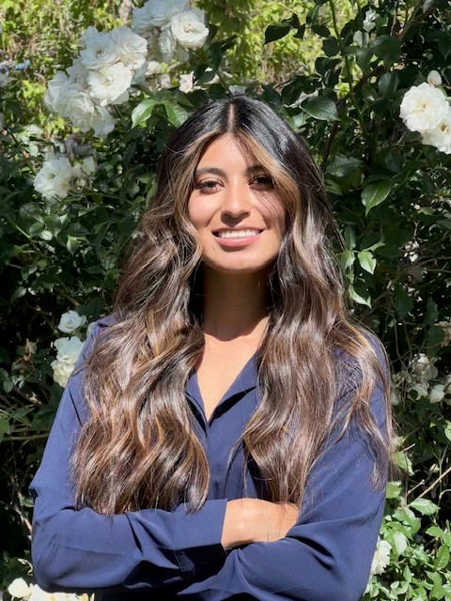
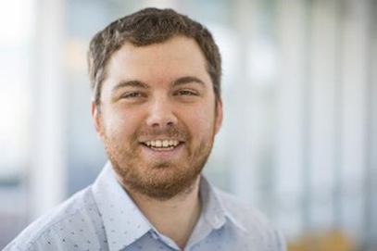
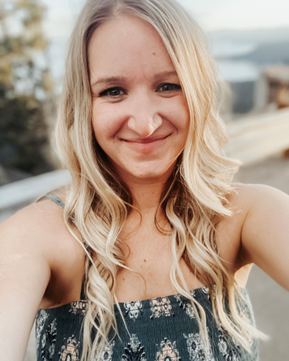
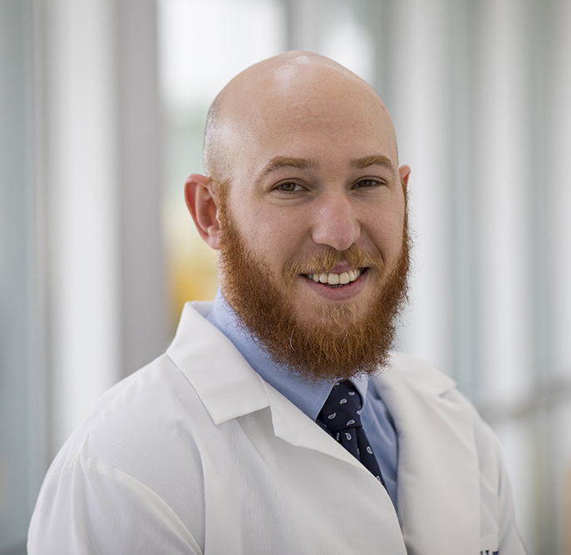
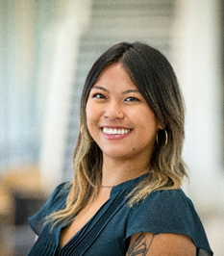
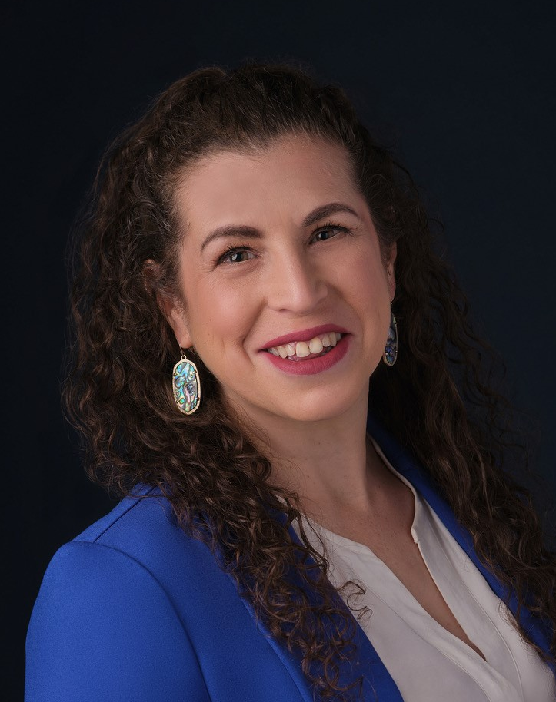
Introductions: Meet Our Hub Support Coordinators
Jenny Escalera-Guerrero
Program Coordinator, Project ECHO Nevada
University of Nevada, Reno
ECHO Coordinator & Facilitator
Sandy Hartman
Associate Director, Community Partnerships
American Cancer Society
ECHO Facilitator
Troy Jorgensen
Senior Program Manager, Project ECHO Nevada
University of Nevada, Reno
ECHO Coordinator & Facilitator
Ashley Lach, BA, MHA, CPHQ
HPV Program Manager
American Cancer Society
ECHO Facilitator
Mordechai Lavi, MD
Medical Director, Project ECHO Nevada
University of Nevada, Reno
ECHO Advisor
Alyssa Delle Planas, MPH
Program Coordinator
High Sierra AHEC
ECHO Coordinator & Facilitator
Allison Rosen, MS
Director, Project ECHO
American Cancer Society
IT Coordinator
Notes:
Sandy
The team members listed on this slide will be facilitating sessions and working behind the scenes to ensure our ECHO program runs smoothly.

Slide 12

Breakout rooms (5-6 people per room)
10 minutes total
Discuss: Name, title, organization, and what you hope to learn during this ECHO series
Breakout:
Introductions
Notes:
Sandy to provide instructions for introductory breakout session
Breakout rooms (5-6 people per room)
10 minutes total
Discuss: Name, title, organization, and what you hope to learn during this ECHO series

Slide 13

Participation Poll
Have you ever participated in an ECHO before?
Notes:
Sandy: as participants start to filter back into the main room, we will have a poll pulled up asking
“Have you ever participated in an ECHO series before?” Yes or No
Transition to Troy to introduce ECHO model

Slide 14

What’s something interesting you heard?
Notes:
Sandy to circle back and ask 2-3 participants something interesting they heard during the breakout session.
Transition to Troy

Slide 15
Session 0:
Introduction to the ECHO Model
Troy Jorgensen
Senior Program Manager, Project ECHO
University of Nevada, Reno
Notes:
Troy

Slide 16

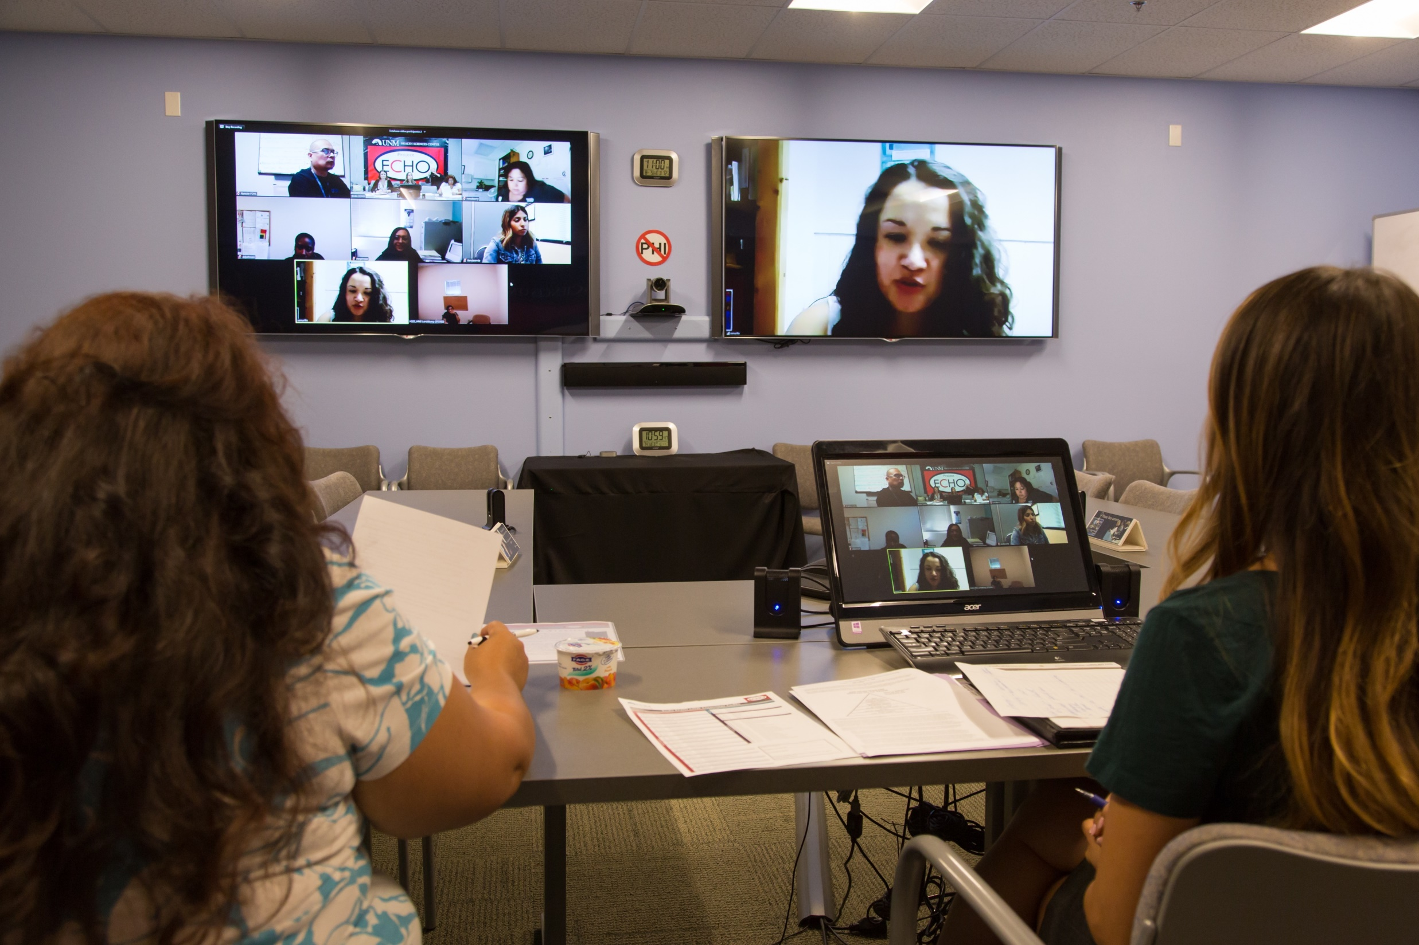

ECHO
Is All Teach,
All Learn
Interactive
Co-management
of cases
Peer-to-peer
learning
Collaborative
problem solving
Notes:
Troy: A high-level review of what ECHO is
ECHO is a ‘hub and participant’ model to share knowledge in an effort to reduce health disparities, often in underserved or remote areas using the “tele-mentoring” approach
ECHO creates a learning loop – with a team of experts in the “Hub” sharing information to our “participant” learners, who can then translate this information into their care and practice
Moving Knowledge, Not People
Empowering people to make a difference in their communities with the right knowledge, at the right place, at the right time
Builds communities of practice through virtual mentoring & learning
One-to-many intervention proven effective to reduce disparities, strengthen health systems, & drive collaborative solutions for local priorities
Effective/Efficient vehicle for dissemination of evidence-based strategies to improve cancer outcomes
Participants attend virtual case-based sessions with subject-matter experts
The participants and subject-matter experts all learn from each other: knowledge is generated, refined and tested by local experience. This “all teach, all learn” method democratizes expertise and makes it relevant to local cultural contexts.​

Slide 17
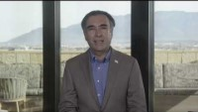
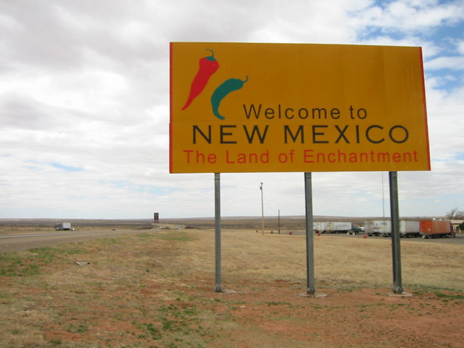
Project ECHO- How it Started
ECHO- Extension for Community Healthcare Outcomes
Both American Cancer Society & University of Nevada, Reno are ECHO Hubs
Notes:
Troy: As we get started it is best if I tell you what Project ECHO stands for, ECHO stands for….​
In which state was project ECHO started?​

Slide 18
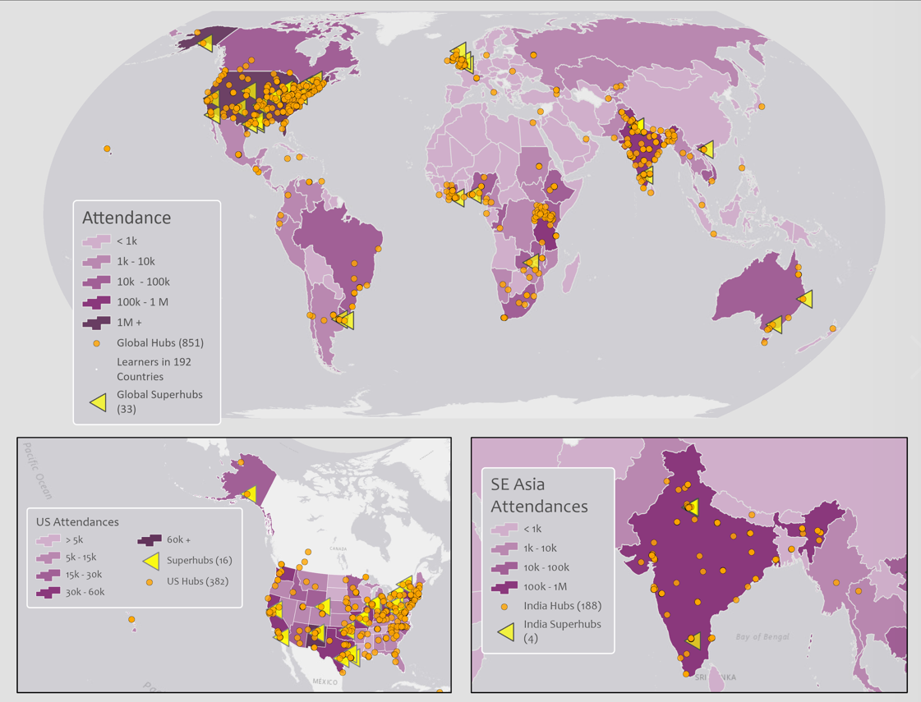
Global
Hubs &
Superhubs
Notes:
Troy:

Slide 19
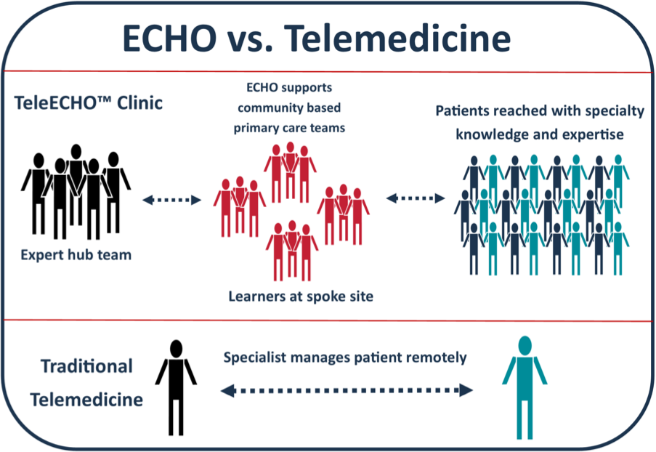
The ECHO model is not traditional telemedicine where the treating physician retains responsibility for managing the patient.
Notes:
Troy: Should we change this picture to ECHO vs. Webinar?

Slide 20


Expectations of Participants
Commits to helping build a learning collaborative community amongst participants to foster best practice sharing.
Attend all ECHO sessions
Actively participate with camera on and ask questions when appropriate
Deliver one case presentation over the course of the ECHO series
Complete all pre/post evaluation surveys to receive continuing education credit
Reminder: If you have not already, please COMPLETE the Pre-ECHO Survey Link: https://forms.microsoft.com/r/9jmgVixV7n
Notes:
Troy:

Slide 21

Anatomy of an ECHO Session
What is a Case Presentation?
Welcome & introductions (5 minutes)
Announcements & session overview (5 minutes)
Brief Didactic Lecture/Presentation (15-20 minutes )
Didactic Q/A (5 minutes)
2 Case Presentation(s) (20 minutes each)
  Introduction & Case presentation (3-5 minutes)
  Clarifying Questions – 1st to hub SMEs, 2nd to other participants (5 minutes)
  Summary of case: provided by Dr. Cucalon(2 minutes)
  Recommendations – 1st to participants, 2nd to hub SMEs (5-7 minutes)
  Wrap-up & Summary of Recommendations : provided by Dr. Cucalon (1 minute)
Closing remarks, Wrap-Up & Post-Session Survey Poll (5 minutes)
Case presentations are vital to each ECHO session. The case presentation is based on a real-life scenario and is an opportunity for a participant to request advice and recommendations from other participants and the Hub SME’s.
These cases are challenges or perceived barriers that can be either system-level or patient-level.
SME’s and participant learners will offer their guidance. This sections of each ECHO session serves as an interactive learning feedback loop for all attendees.
For more about the ECHO Model™ or Project ECHO, please visit www.echo.unm.edu
Notes:
Troy:
The Case-Based discussions are supplemented with short Didactic Presentations to improve content knowledge and share evidence-informed best practices
CME/CEU link

Slide 22
All meeting materials, including the case presentation notes, will be disseminated and uploaded within one week of the session to the ACS ECHO website
Notes:
Troy:
Transition to Ashley

Slide 23

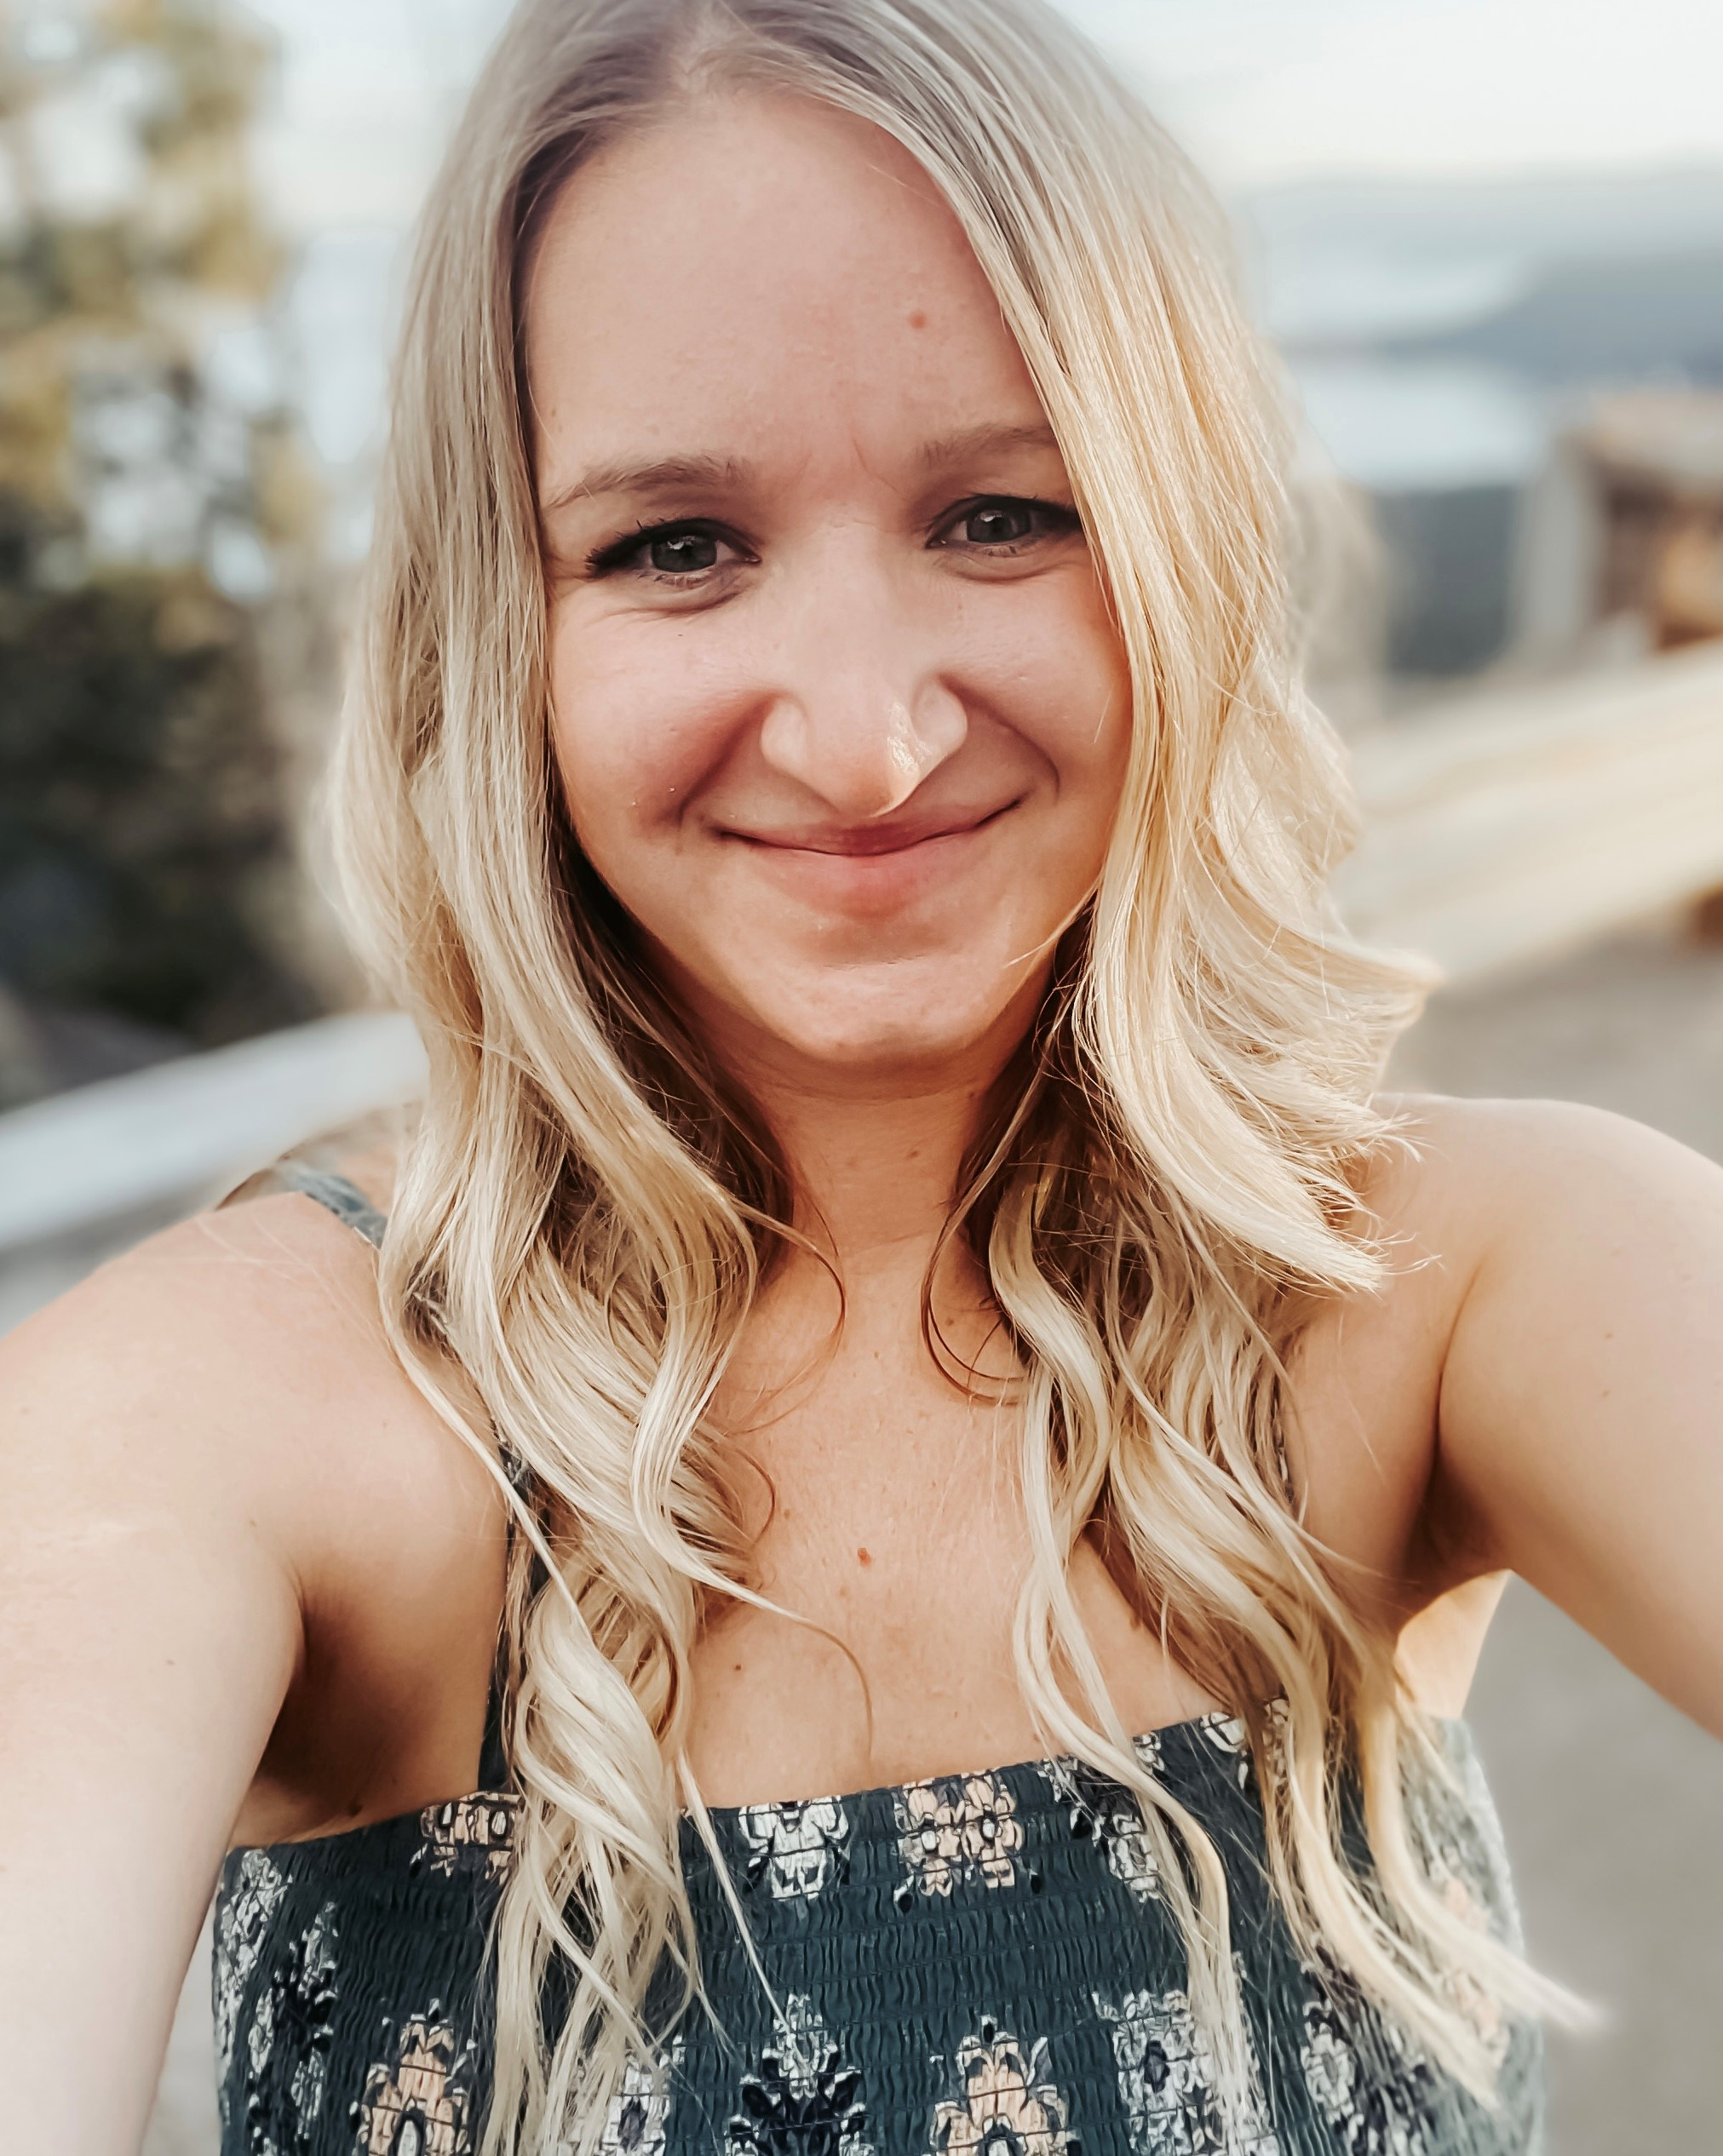
Session 0:
Sample Didactic Presentation
Ashley Lach, BA, MHA, CPHQ
HPV Program Manager
American Cancer Society
Notes:
Ashley

Slide 24



Community Health Worker ECHO Series
Project Overview
Mountain West HPV Vaccination Project
Overview: The American Cancer Society received funding in 2020 for a project titled “Mountain West HPV Project – An ACS | NCI CCC Partnership Model to Reduce Geographic Disparities in HPV Vaccination Rates for Adolescents Living in Rural States”. The states included in this work are Idaho, Montana, Nevada, Utah, and Wyoming; states that are experiencing multiple disparities, notably geographic and gender gaps, in HPV vaccination rates.
Quality Improvement
Regional Consortium
Professional Education
Notes:
Ashley

Slide 25





Nevada
Ranked
51/63
States and Local Areas for up-to-date HPV vaccination
61.7%
of adolescents were fully vaccinated against HPV last year, nationally
Gender Disparity
HPV Vaccination Rates
Other Adolescent Vaccines
38%
Up-to-date HPV Vaccination, Males and Females (before 13th birthday)
2018-2020 data
≥ MenACWY
89.5%
56.5%
Up-to-date HPV Vaccination, Males and Females (13-17 yr.)
≥ Tdap
54.9%
58%
91.2%
Where are the gaps and opportunities?
Renewed focus on HPV vaccinations overall
Emphasis on starting at age 9 and completion by age 13
Focused effort on adolescent females
Opportunity for rural and frontier outreach
6.4% from 2020
47.2%
Geographic Disparity
Survey Years 2015-2019
38.9%
Notes:
Ashley- pull 2022 NIS teen data for last ECHO session
So how is Nevada doing with HPV vaccinations? This slide showcases the most recent National Immunization Survey for teens. Nationally, 61.7% of adolescents 13-17 years of age are fully vaccinated against HPV. Nevada sits at 56.5%, which is below the national average. However, we did see a 6% uptake from 2020 to 2021.
When you compare HPV to other adolescent vaccines like Men and Tdap which are typically bundled at the 11-12 year range, both of those vaccines sit closer to a 90% threshold so we know providers are not recommending HPV in the same manner. Males are being vaccinated more frequently than their female counterparts, and their significant geographic disparities when you compare urban vs rural and frontier communities. When you look at state data, there’s opportunity in the rural, quad, and Clark counties in Nevada.
Additionally, when you look at the “on time” age group which is before the 13th birthday, only 38% of adolescents have completed their HPV vaccine series.
During our small state meeting in June, Winter Tucker from the state immunization program, shared that in Nevada African American and Hispanic adolescents have the highest uptake of HPV, Tdap, and Mening than any other ethnic group. The Asian pacific islander group has the lowest HPV vaccination uptake year over year. However, there has been a decrease in HPV vaccination over the las 5 years among the American Indian/Native American group. Which was a significant finding since nationally, Indian Health Services and tribal clinics tend to have higher HPV vaccination rates than other racial and ethnic group.
Data is sourced from NIS-Teen (CDC, 2020) https://www.cdc.gov/vaccines/imz-managers/coverage/teenvaxview/data-reports/index.html
All the stats are for Up-to-Date Completion for People aged 13-17.

Slide 26
HPV Vaccination Project ECHO-Texas
Notes:
Ashley

Slide 27

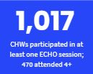
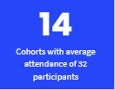
What have we done so far?
“I would just say if someone is questioning whether they should participate or not, I think it's worth it and it's valuable. They will be able to learn from others just being transparent with their stories or just different situations that possibly that person hasn't come across yet...”
Notes:
Ashley

Slide 28
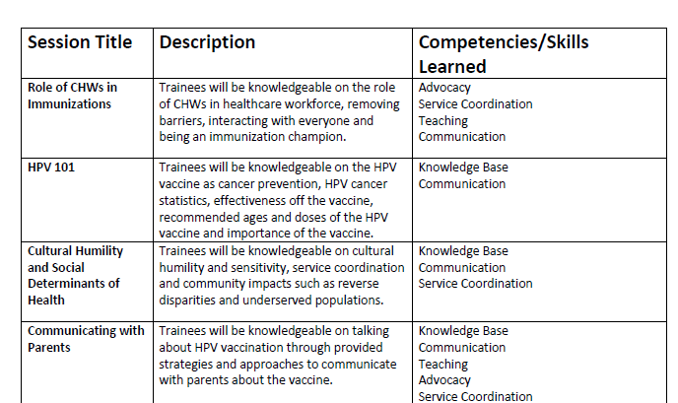
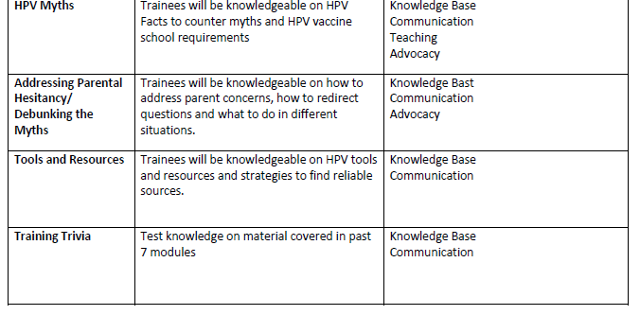
Draft Community Health Worker’s ECHO Series
Notes:
Ashley

Slide 29
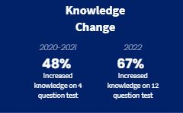
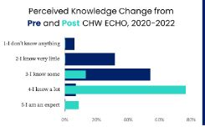
Impact
Notes:
Ashley: In all cohorts, there were positive changes in vaccination beliefs, confidence discussing the vaccine, and decreased misconceptions of the HPV vaccine
Transition to Troy and Liz

Slide 30




The Case Presentation Process
Participants will submit their case presentation forms at least three business days(Friday) prior to the ECHO session. The case presentation form serves as the sole requirement.
SME’s will receive the case presentation at least 48 hours in advance and can provide advance written feedback and or verbal feedback during the ECHO session.
The case presentation does NOT have to be thematic to the didactic presentation (while it may improve the session flow).
One of the ECHO coordinators will type the key takeaways and recommendation, which will be sent out to in the post-session recap.
Case presentations are the heart of the ECHO Model™, ensuring that “everyone teaches, everyone learns”
Notes:
Troy:
The case presentation is often described as the virtual grand-rounds and really serves as one of the most important parts of the ECHO. As we mentioned earlier, what set ECHO apart from a traditional webinar is the combination of both didactic and case-based learning. The case presentation allows participants to present a case and or a problem and then, solicit real-time guidance and feedback from our esteemed experts. It is also a learning opportunity for our subject matter expert in that you will hear the realities of issues that exist from our participants.

Slide 31
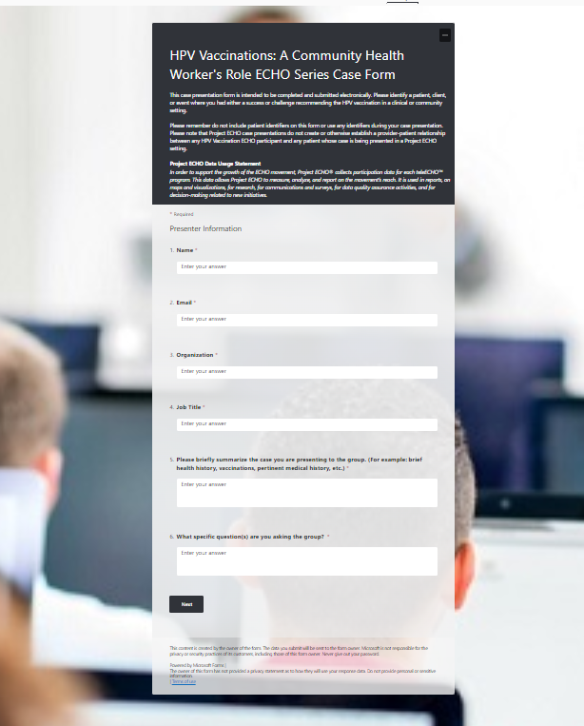


How do I submit a case presentation?
Case presentations will be submitted via Microsoft Forms.
To access the form: https://forms.microsoft.com/r/WkrwSzSpQZ
Please submit your form 3 business days before the ECHO session, so that one of the ECHO coordinators can put together a comprehensive slide detailing your case.
  Note: The Case Presentation Form is a “Living” Document
Notes:
Troy: ACS Staff Lead, we will quickly go over the form, which is pretty self-explanatory and will change throughout the trajectory of our project. The ACS team is happy to meet with the case presentation team for a brief meeting to walk through this. Remember, this is an opportunity to learn from some of the very best….from your state and from across the United States.

Slide 32
Session 0:
Sample Case Presentation
Liz Partida, CHW
Cancer Care & Prevention Coordinator
Community Health Alliance
Notes:
Troy to introduce Liz

Slide 33
Session 0 Case Study
Addressing Lung Cancer Biomarker Testing Through Project ECHO
Provided by: Liz Partida, CHW
Community Health Alliance
Focus: HPV Vaccination Case
Patient Hx
12 y/o Hispanic Male
Attended Family Health Fair with his mother and 17 y/o brother
Received vaccines at age 11 and was up-to-date on all required vaccines
Had not begun the HPV Vaccination Series
Well-educated, good income
Diagnosed w/grade 2 glioma in 2013
Upgrade
ed to WHO grade 4 glioblastoma in 2020
Key Elements
Patients mother spoke to Cancer Care Coordinator at Family Health Fair
Patients mother was unaware if her son had received the HPV vaccine or that it was needed
HPV Education was provided to the parent as cancer prevention for males and females
Patients parent expressed concern of not vaccinating her child sooner after receiving education
Barriers/Challenges
Patients mother was unaware of the importance of the HPV vaccine and had not received prior education
Patients mother was hesitant as she believed it was not necessary for her son to receive the vaccine as he did not have a cervix
The HPV vaccine is not a required vaccine for school
Notes:
Liz

Slide 34
Session 0 Case Study
Addressing Lung Cancer Biomarker Testing Through Project ECHO
Provided by: Liz Partida, CHW
Community Health Alliance
Focus: HPV Vaccination Case
Discussion & Questions
How would you present the HPV vaccine to someone who has never heard about it?
Would you emphasize the importance for cancer prevention to Male patients?
How can we remove stigmas and misinformation regarding the HPV Vaccine?
Barriers/Challenges (reference)
Patients mother was unaware of the importance of the HPV vaccine and had not received prior education
Patients mother was hesitant as she believed it was not necessary for her son to receive the vaccine as he did not have a cervix
The HPV vaccine is not a required vaccine for school
Notes:
Troy & Liz

Slide 35
Curriculum Schedule
Date
Session
Topic
Didactic Presenter
August 2nd
12-1:15pm PST
Session 1
Cody Wagner
Nevada Community Health Worker Association
Role of CHWs in Immunizations
August 16th
12-1:15pm PST
Session 2
Dr. Vanessa Slots
M Health Fairview
HPV 101
August 30th
12-1:15on PST
Session 3
Cultural Humility and Social Determinants of Health
Dr. Talee Vang
Hennepin Healthcare
September 13th
12-1:15pm PST
Session 4
Communicating with Parents about the HPV Vaccination
Aaron Blackham
September 27th 12-1:15pm PST
Session 5
Busting HPV Vaccination Myths
Dr. Jose Cucalon
University of Nevada, Reno
October 11th
12-1:15pm PST
Session 6
Addressing Parental Hesitancy Around HPV Vaccinations
Dr. Sean O’Leary
Children’s Hospital Colorado
October 25th
12-1:15pm PST
Session 7
Implementation Science: CHW’s as HPV Champions
Liz Partida, CHW
Community Health Alliance
35
Notes:
Ashley

Slide 36

    A member of the support team will confirm your case presentation date and work with you to ensure your experience is easy AND valuable.
Case Sign Up Schedule
Date
Session
Participant Name #1
Participant Name #2
Alternate Participant
August 2nd
12-1:15pm PST
Session 1
August 16th
12-1:15pm PST
Session 2
August 30th
12-1:15on PST
Session 3
September 13th
12-1:15pm PST
Session 4
September 27th 12-1:15pm PST
Session 5
October 11th
12-1:15pm PST
Session 6
October 25th
12-1:15pm PST
Session 7
36
Notes:
Ashley

Slide 37
Questions
Notes:
Ashley & Troy

Slide 38








A Few Reminders
Next ECHO Session: August 2nd, 2023 from 12-1:15pm PST via Zoom
  Next Didactic Presenter: Role of CHW’s in Immunizations with Cody Wagner
  Materials and Resources will be made available within one week. All resources will be available on the ACS ECHO Website
  Case Presentations - Participants: Ready to schedule your Case Presentation? Let us know ASAP, please. Hub Subject Matter Experts (SMEs): All future case presentations will be shared with you at least 24-hours in advance
  Additional Feedback on Today’s Session? Let us know via the post-session survey!
  Pre-ECHO Survey: If you have not yet completed, please take our Pre-ECHO assessment by clicking this link https://forms.microsoft.com/r/9jmgVixV7n
  Questions: Contact Ashley Lach, HPV Program Manager, Ashley.Lach@cancer.org OR Jenny Escalera-Guerrero, Program Coordinator-Project ECHO Nevada, jescaleraguerrero@med.unr.edu
Notes:
Ashley

Slide 39
Post-Session Poll
Notes:
Ashley
Vaccination rate
ECHO facilitation?
Shoot an email

Slide 40
Thank You
Notes:
Ashley

