Slide 1
Welcome!
Please put your name and email in the chat box. If you are sharing a computer with others, please include everyone participating today
We encourage you add your preferred pronouns with your name and image.
Notes:
Elizabeth

Slide 2
LGBTQ+ and Cancer Care Through the Primary Care Lens Project ECHO: Session 3
“HPV Could Affect You and Me Whether We’re Cis, Straight, Queer, or LGBT”
8.26.2022
Notes:
Elizabeth

Slide 3
Today’s Agenda
01 | Housekeeping, Agenda Preview, & Introductions (10 minutes)
02 | Didactic Presentation: HPV vaccination and HPV related cancer risk factors (15 minutes)
03 | Didactic Q/A (5 minutes)
04 | Case Presentation (5 minutes)
05 | Case Presentation Recommendations & Discussion (15 minutes)
06 | Post-Session Poll (have your phone ready) & Wrap Up (5 minutes)
Notes:
Elizabeth

Slide 4
The American Cancer Society is proud to present this ECHO series
in part through funding support provided by Merck & Co., Inc.
Notes:
Elizabeth

Slide 5
Session 3 Addressing Lung Cancer Biomarker Testing Through Project ECHO
Each ECHO session will be recorded and will be posted to a publicly-facing website
You will be muted with your video turned off when you join the call. Use the buttons in the black menu bar to unmute your line and to turn on your video. If you do not wish to have your image recorded, please turn OFF the video option.
Today’s materials will be made available on our ACS ECHO website
Please type your name and organization in the chat box
This ECHO session takes place on the Zoom platform. To review Zoom’s privacy policy, please visit zoom.us/privacy
Remember: Do NOT share any personal information about any patient
Questions about Zoom? Type them in the chat box
Notes:
This slide must be read. ECHO disclosures and for those who are not joining by video.
When we get to discussion we encourage you to come on camera for the conversaion

Slide 6
Welcome to our Facilitator for today!
Steven Allon, MD (he/his)
Vanderbilt University Medical Center
Assistant Professor of Medicine
Division of General Internal Medicine and
Public Health

Slide 7
WELCOME TO OUR SPOKE SITES!
Domino’s Farm Family Medicine – Michigan
Indiana University Health
Memorial Hospital & Health Center- Indiana
University of Louisville Family Medicine
Internal Medicine Faculty, Residents and Staff at Vanderbilt Primary Care
Notes:
Facilitator

Slide 8
Didactic Presentation
Mollie E. Aleshire, DNP, MSN, APRN, FNP-BC, PPCNP-BC, FNAP she/her/hers
Assistant Professor
University of Louisville
School of Nursing

Slide 9
HPV COULD AFFECT YOU AND ME WHETHER WE’RE CIS, STRAIGHT, QUEER, OR LGBT
Notes:
Good Afternoon Thank you for the opportunity to share with you this didactic content I have entitled
“HPV COULD AFFECT YOU AND ME WHETHER WE’RE CIS, STRAIGHT, QUEER, OR LGBT”

Slide 10
WHY FOCUS ON LGBTQ+ and HPV?
Echo Objectives:
1
Reiterate that HPV vaccination is cancer prevention
2
Emphasize that conversations are key to HPV prevention
3
Explore misconceptions about HPV cancer risks and screening needs
4
Review HPV prevention strategies
©2022 American Cancer Society, Inc. Models used for illustrative purposes only.
Notes:
WHY FOCUS ON LGBTQ+ and HPV?
Here are today’s Echo Objectives that will answer that question
HPV is VERY common, with approximately 80% of individuals having an HPV infection during their lifetime, and about 15 types of HPV can cause cancer

Slide 11
HPV VACCINATION IS CANCER PREVENTION
Notes:
First, HPV VACCINATION IS CANCER PREVENTION

Slide 12
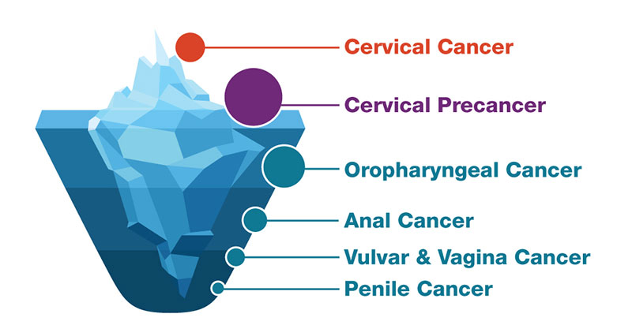
HPV VACCINATION IS CANCER PREVENTION We need to focus on prevention.
GRAPHIC SOURCE: Centers for Disease Control (CDC)
Notes:
We need to focus on HPV cancer prevention because we cannot screen for most HPV cancers
We can only screen for cervical cancers and precancers, which as this figure illustrates,
are only the tip of the iceberg since HPV causes other types of cancer,
including oral cancers which are increasing in incidence

Slide 13
BENEFITS OF VACCINATING AT AGE 9 Provider/System/Public Health Perspective
Earlier initiation of HPV vaccination:
Offers more time for completion of the series
Increases the likelihood of vaccinating prior to first HPV exposure
Decreases the need to discuss sexual activity
Decreases requests for only vaccines that are “required”
Has been shown by several systems to increase vaccination rates
Has been shown to be acceptable to systems, providers, and parents
©2022 American Cancer Society, Inc. Models used for illustrative purposes only.
SOURCES: Goleman MJ, Dolce M, Morack J. Acad Pediatr. 2018;18:769-775; St Sauver, et al. Prev Med. 2016;89:327-333; and Biancarelli et al. J Pediatr. 2020;217:92-97
Notes:
The ACS recommends starting HPV vaccination at age 9 because if healthcare practices have strong, early HPV vaccine recommendations for ALL preteen patients it can help prevent challenges later such as an adult transmasculine person who was assigned female sex at birth with an abnormal pap test and the anxiety and gender dysphoria that individual may face with that test result and its sequelae

Slide 14
CONVERSATIONS ARE KEY TO HPV PREVENTION
Notes:
Secondly, Conversations and clear communication are key to HPV prevention

Slide 15
WHICH TERMS SHOULD I USE WITH MY PATIENTS...?
LGBTQ2SIA+ or SGM or…?
Language is powerful
Use person-centered language
Use gender-neutral language
Respect how people self-identify
Use preferred pronouns
SOURCE: GLAAD Media Reference Guide – 11th Edition
IMAGE SOURCE: Jess Mills, artist, (2022) used with permission
Notes:
You may be wondering what are the best terms to use with patients? Do we use the LGBTQ+ acronym? Something else? SGM for sexual and gender minorities?
Often the LGBTQ+ term has been used and embraced by the community while medical literature uses other terms such as SGM for sexual and gender minorities o
We may need to describe patients in our care but used person-centered language *based on their medical needs, sex assigned at birth or sexual practices. But describe rather than label
– for example, a person who has sex with men may be important to know medically, but calling that individual gay if they don’t use that term may be offensive.
Gender neutral language is essential – e,.g. partner, parent, person – ask if you don’t know a relationship
Respect how people self-identify and use this language with their permission – use correct pronouns (practice
Most importantly, Language is powerful
Most importantly, everyone should be identified in the way they prefer based on how they self-identify There is also a difference in identifying someone in a medical note based on their medical needs (e.g. AFAB), sexual practices (MSM), and what may be their preferred identity and pronouns – e.g. nonbinary, they/them
Most importantly, Language is powerful

Slide 16
RECOMMENDATIONS MATTER
The best predictor of vaccination uptake provider recommendation.
SOURCE: American Cancer Society
©2022 American Cancer Society, Inc. Models used for illustrative purposes only.
Notes:
Recommendations by affirming providers are particularly important for LGBTQ+ patients and HPV vaccination is likely no different; repeatedly, studies have shown that a provider recommendation is the best predictor of vaccination uptake whether this be a choice made by parents of preteens, a joint decision with an LGBTQ+ teenager and a parent, or a decision by an adult up to age 26 about catch-up HPV vaccinations.
Studies show that the best way to recommend HPV vaccination regardless of age is as cancer prevention.

Slide 17
HEALTHCARE EXPERIENCES OF LGBTQ+ PATIENTS
AND THEIR PARENTS
Stigma (negative and unfair beliefs)
Discrimination (unfairly treating a person or group of people differently)
Lack of access to culturally- and orientation-appropriate, affirming medical and support services
Heightened concerns about confidentiality
Fear related to being “outed”
Fear of talking about sexual practices, gender identity, or sexual orientation
SOURCE: Centers for Disease Control (CDC)
Notes:
LGBTQ+ patients and their parents face many challenges with the healthcare system that can negatively affect their willingness to even seek healthcare and particularly preventive care.
Stigma, discrimination, and lack of affirming care are all commonplace.
Additionally, these individuals face heightened concerns about confidentiality, being outed, and fear about talking about their sexual practices and gender identity or sexual orientation.
Addressing these concerns and creating safe, welcoming, affirming environments is a responsibility of everyone in a healthcare office and can affect future healthcare outcomes for these patients!

Slide 18
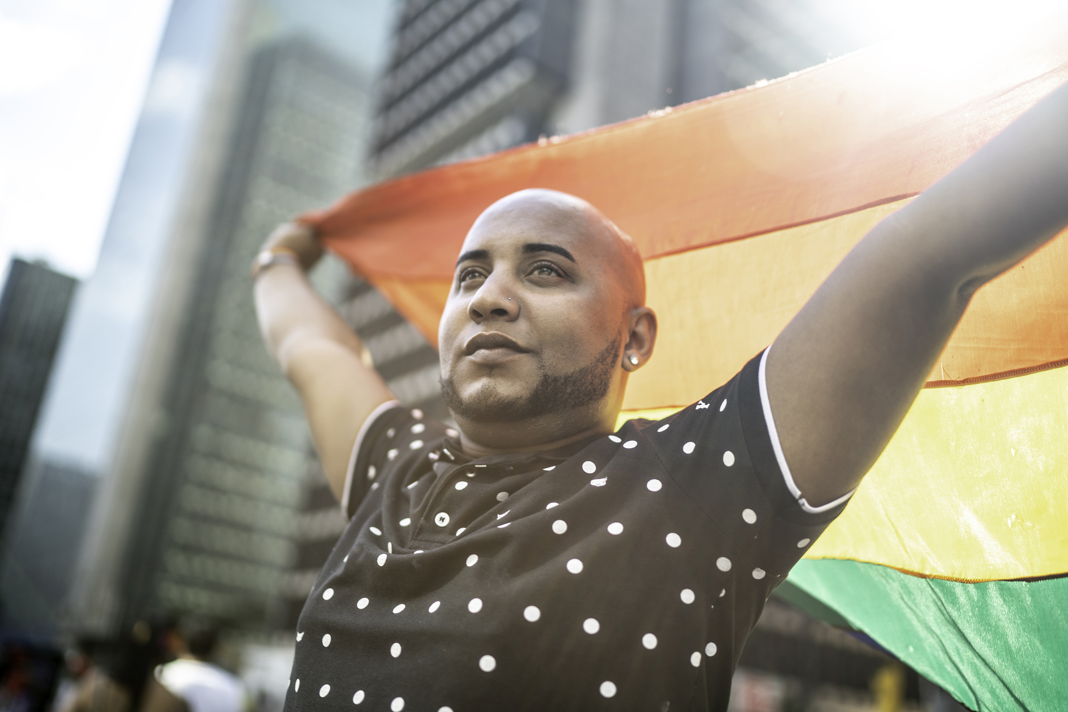
Understanding the Risks
HPV risk increases with:
Increased number of lifetime sexual partners
Immunocompromised individuals
Co-infection with other sexually transmitted infections
Vesco et al. (2011) Risk Factors and Other Epidemiologic Considerations for Cervical Cancer Screening: A Narrative Review for the U.S. Preventive Services Task Force. Ann
Intern Med, 155, 698-705.
Schiffman et al. (2011) Human Papillomavirus Testing in the Prevention of Cervical
Cancer. J Natl Cancer Inst,103(5), 368-383
©2022 American Cancer Society, Inc. Models used for illustrative purposes only.
Notes:
HCPs must understand the risks for HPV and cervical cancer so that they can share these accurately with patients and parents when asked.
These are listed above for your review.

Slide 19
USE THE 5 “Ps”
Sexual History Dialogue Guide
1
Partners
2
Practices
3
Protection from STIs
4
Past reproductive and sexual history
5
Pregnancy intention
Source: Centers for Disease Control (CDC)
©2022 American Cancer Society, Inc. Models used for illustrative purposes only.
Notes:
Although applicable to all patients, with LGBTQ+ teen and adult patients, there may be either discomfort or even unwillingness by providers to discuss sexual history.
Often there is a notion that sexual history for lgbtq+ persons should somehow differ from that of cisgender and heterosexual persons, yet this is inaccurate and only highlights providers general discomfort with sexual histories.
The CDC recommends considering the 5 Ps for everyone to guide the essential aspects of a sexual history.
Partners
Practices -
Protection from STIs
Past reproductive and sexual history, and
Pregnancy intention

Slide 20
MISCONCEPTIONS ABOUT HPV CANCER RISKS AND SCREENING NEEDS
Notes:
Often there is lack of clear knowledge related to how HPV can be transmitted – that it can be transmitted through skin-to skin contact and that this can thus be through contact with different body areas.
Also, HPV can be transmitted via sex toys and there can be simultaneous infections in the cervix and anus.
Organ inventory

Slide 21
CHALLENGING ASSUMPTIONS: HPV TRANSMISSION
HPV can be transmitted through any skin-to-skin contact
Genital skin-to-skin touching
Digital-vaginal contact
Oral-vaginal contact
Penile-vaginal contact
Transmission may be feasible via sex toys
Both cervix and anus may be infected
Marrazzo et al (2000) Genital human papillomavirus infection in women who have sex with
women: A review. Am J Obstet Gynecoll,183,770-4.
Anderson et al (2014) A study of human papillomavirus on vaginally inserted sex toys, before and after cleaning, among women who have sex with women and men Sex Transm
Infect, 0, 1–3.
Moscicki et al (2012) Updating the Natural History of Human Papillomavirus and Anogenital
Cancers. Vaccine, 30(5), F24-F33.
Notes:
Often there is lack of clear knowledge related to how HPV can be transmitted – that it can be transmitted through skin-to skin contact and that this can thus be through contact with different body areas.
Also, HPV can be transmitted via sex toys and there can be simultaneous infections in the cervix and anus.
Organ inventory

Slide 22
COMMON MISCONCEPTIONS ABOUT HPV RISK AND LGBTQ+ POPULATIONS…
People who are LGBTQ+ have fewer/more sexual partners.
People who never have penetrative vaginal sex with digits, sex toys, or genitals or only had penetrative sex in the past aren’t at risk for HPV.
Certain LGBTQ+ patients only engage in certain sexual practices,
making their HPV risk different.
A person is at minimal risk of HPV if they have never had PIV (Penis
in Vagina) sex, and it’s not important to encourage HPV vaccination
or cervical cancer screening if someone has not engaged in PIV.
Coughlin et al (2004) Physician Recommendation for Papanicolaou Testing Among U.S. Women,
2000. Cancer Epidemiol Biomarkers Prev, 14, 1143.
Notes:
HPV risk misconceptions related tp LGBTQ+ populations include that
those who are LGBTQ+ have either fewer or more sexual partners
That if there is no penetrative vaginal sex , there is no HPV risk
That those who are transmasculine or other LGBTQ+ populations do not engage in penis-in-vagina or PIV sex, decreasing their HPV risk, or
That a person is at minimal risk of HPV if they have never had PIV sex
These myths have been shown to be present not only in LGBTQ+ populations but often healthcare providers also subscribe to them despite evidence to the contrary
People with certain LGBT identities only engage in certain sexual practices, thus decreasing their HPV risk,, for example, people may assume that someone who identifies as lesbian never has PIV sex thus decreasing their HPV risk, or that gay men have more anal insertive sex thus increasing their HPV risk

Slide 23
HPV PREVENTION STRATEGIES
Notes:
As we close, I want to briefly remind you of HPV prevention strategies

Slide 24
HPV VACCINATION GUIDELINES
Boys and girls
Age 9 - 12 = ON TIME; Can vaccinate LATE at ages 13 to 26
ACS: Individuals ages 22 to 26 who were not previously vaccinated should be informed that vaccination at older ages is less effective in lowering cancer risk
2 doses*
SOURCE: American Cancer Society HPV vaccine (Accessed March 2022)
Notes:
Here are the HPV vaccination guidelines that remind us that initiation of HPV vaccination recommendation early is essential

Slide 25
WHAT ABOUT ADULTS?
The American Cancer Society does not recommend HPV vaccination for adults older than 26 years.
SOURCES: Meites,et al. MMWR Morb Mortal Wkly Rep. 2019;68:698-702; Laprise, et al. Ann Intern Med. 2020;172:22-29; and Centers for Disease Control and Prevention. 2019
©2022 American Cancer Society, Inc. Models used for illustrative purposes only.
Notes:
Catch up vaccinations should be recommended until age 26.
Although not endorsed by ACS, of note, the advisory committee on immunization practices (ACIP) suggests that clinicians may consider discussion and shared decision making with people ages 27-45 years of age most likely to benefit from HPV vaccination

Slide 26
WHEN WE PREVENT HPV, WE DECREASE CANCER RISK FOR YOU AND ME
LGBTQ+ People:
Are at risk of HPV and HPV cancers
Face unique barriers
Providers and clinic staff can take steps to facilitate affirming and safe vaccination and screening experiences
Open and honest assessment of individual patient needs and comfort is key
SOURCE: National LGBTQIA+ Health Education Center

Slide 27
Didactic Session
Q & A
For any terminology questions or requests for clarification please use the chat box
Notes:
Facilitator

Slide 28
Case Presentation
Dr. Janine Fogel
Family Medicine, Gender Health Program
Eskenazi Health
Indiana
Notes:
Facilitator

Slide 29
Session 3 Case Study Addressing Lung Cancer Biomarker Testing Through Project ECHO
Provided by: Dr. Janine Fogel, Family Medicine, Gender Health Program, Eskenazi Health Challenge Focus: Patients that are AFAB (Assigned Female At Birth)
About AFAB Patients
May identify as female, nonbinary, male, or none
If transitioning to male, may have increased incidence of cervical atrophy due to testosterone
Key Elements
Cervical Cancer Prevention & Screening are low in AFAB patients
Hesitancy in patients to follow up on an abnormal Pap
Patients may not have had an exam with a trauma informed provider, leading to less follow through of treatment
Barriers/Challenges
Low HPV vaccine uptake
Less frequent pap testing
High incidence of trauma within the AFAB patient population
Poor access to primary care
May not be asked about screenings if ‘F’ isn’t marked on chart
Discussion Questions
How can we increase HPV vaccination in 9-12 year old patients to focus on prevention?
How can we ensure trauma informed care every time?
What mechanism can we use to flag AFAB patients within the system so that we aren’t missing any eligible patients?
How can we educate primary providers referring on how to do so in a validating way for the AFAB patient?
How can we make sure we are using trauma informed exams every time and by all providers?
How can we help navigate insurance issues for AFAB patients if they’ve marked another gender on paperwork?
What would it look like if it worked?
Appropriate Primary Care prevention with HPV Series
Regular pap/HPV testing at least every 5 years starting at 25
Trauma informed exams every time

Slide 30
Case Presentation Discussion
Feel free to come on camera for the discussion
If you feel comfortable
For any terminology questions or requests for clarification please use the chat box
Notes:
Facilitator

Slide 31
A Few Reminders
NEXT ECHO Session: 9/23/2022 @ 12:30 PM ET/1:30 PM CT
Next Didactic Presenter: Daphna Stroumsa, MD, MPH
Topic: Cervical cancer screening and special considerations for gender diverse patients
Materials and Resources will be made available within one week. All resources will be available on the ACS ECHO Website
Case Presentations Faculty: All future case presentations will be shared with you at 24-hours in advance.
Complete the post-session poll questions
Questions? Reach out to your state ACS lead or Elizabeth.Holtsclaw@cancer.org

Slide 32
LGBTQ+ Cancer ECHO Post-session Survey
tinyurl.com/echosession3

Slide 33
THANK YOU!
See you on 9/23/2022!
Notes:
Julie Waters

